Slide 1
Generative Models VAE/GAN
Taeoh Kim, MVP LAB Seminar
Episode 1b - 2017.7.7

Slide 2
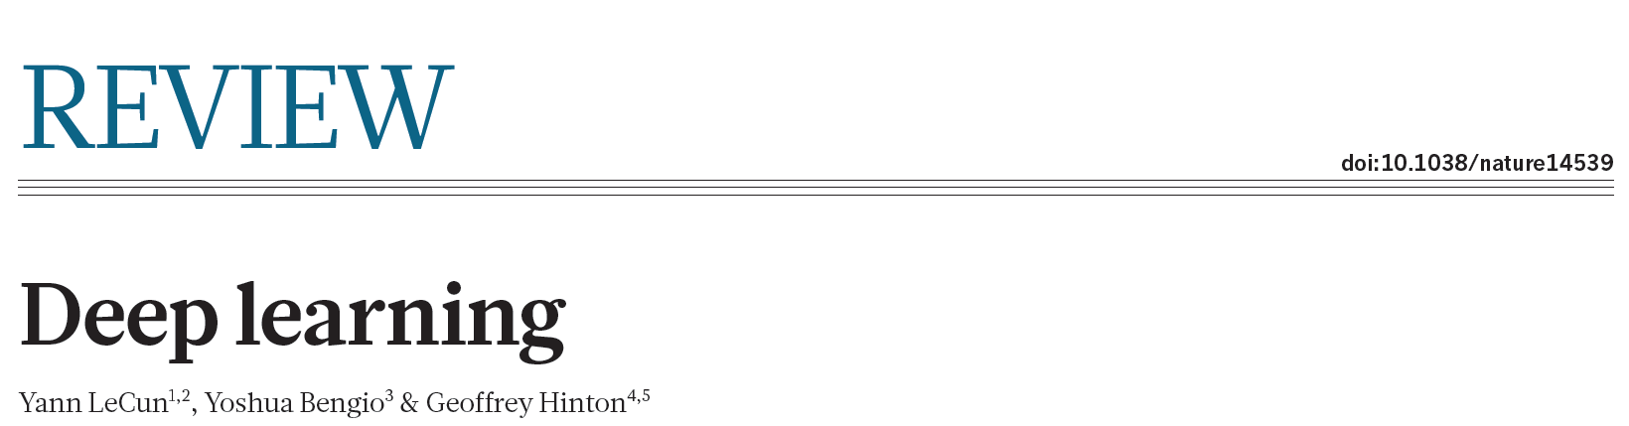
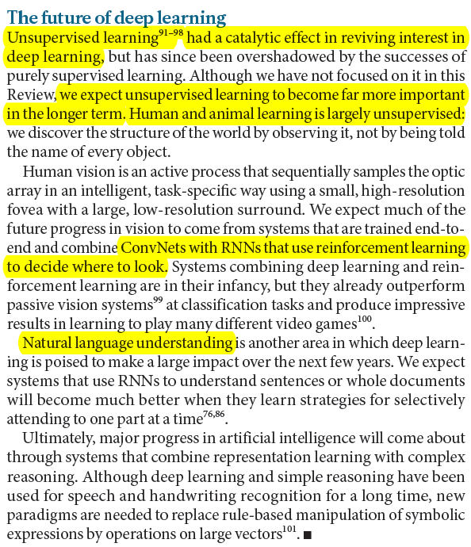
Deep Learning from Nature 2015

Slide 3
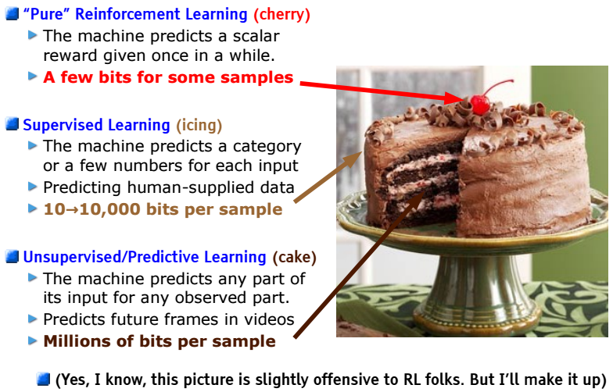
Lecun Says..
Images from NIPS 2016

Slide 4
Generative Models
Discriminant Model
한 Class가 다른 Class와 더 구분되도록
Input의 Feature를 학습한다
본질보다는 “구분”에 초점
Generative Model
Input과 비슷하도록 재-생성해 내는 법을 학습
Feature Learning이 더 잘 된다
그러면 구분하는것은 어렵지 않음

Slide 5
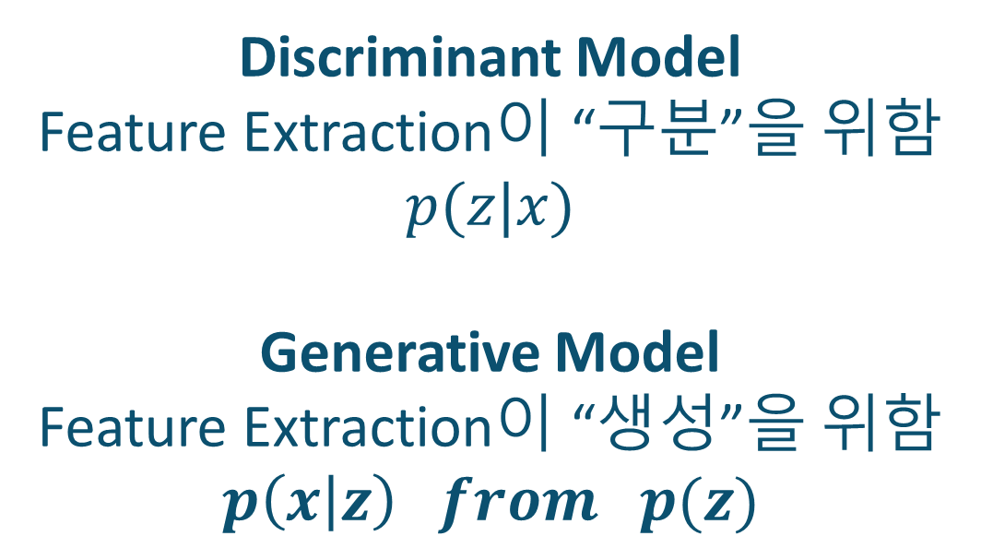
Generative Models
Discriminant Model
Feature Extraction이 “구분”을 위함
$$p(z|x)$$
Generative Model
Feature Extraction이 “생성”을 위함
$$p\left(x | z\right) from p(z)$$

Slide 6
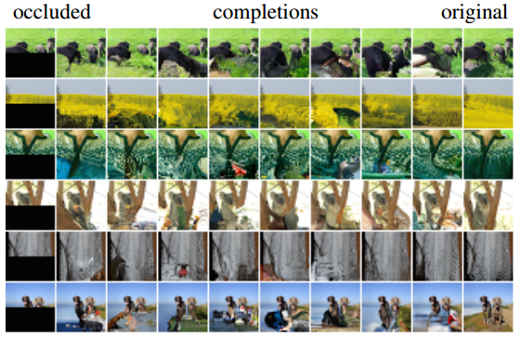
Generative Models: References
PixelRNN, PixelCNN by Oord, 2016, DeepMind

Slide 7
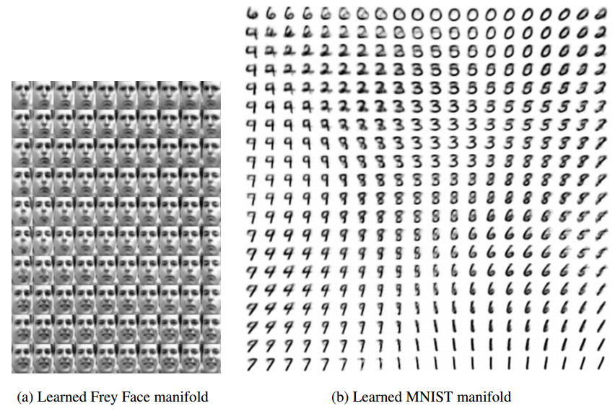
Generative Models: References
VAE by Kingma, 2013

Slide 8
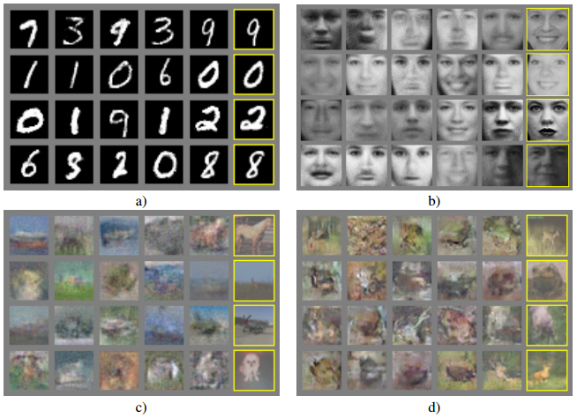
Generative Models: References
GAN by Ian Goodfellow, 2014 NIPS

Slide 9
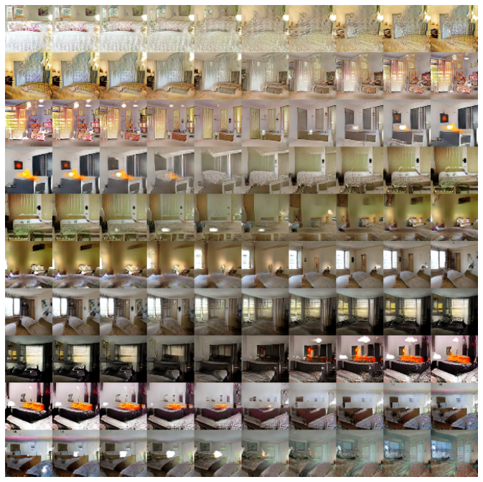
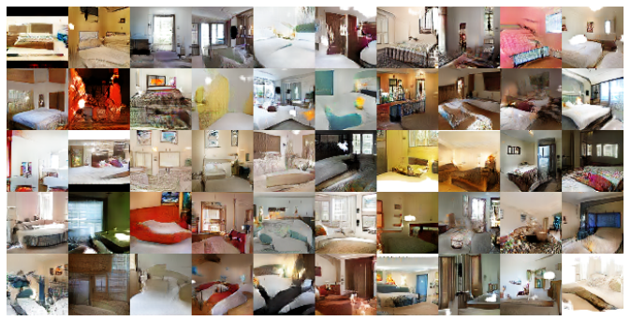
Generative Models: References
DCGAN by Radford, 2016, OpenAI & Facebook

Slide 10
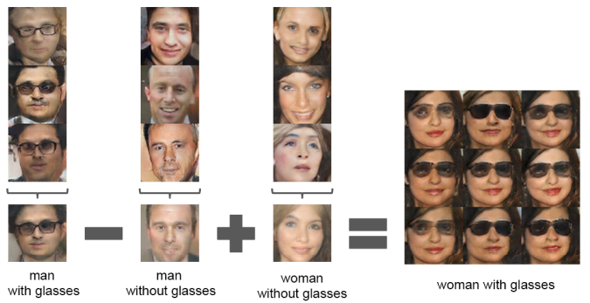
Generative Models: References
DCGAN by Radford, 2016, OpenAI & Facebook

Slide 11
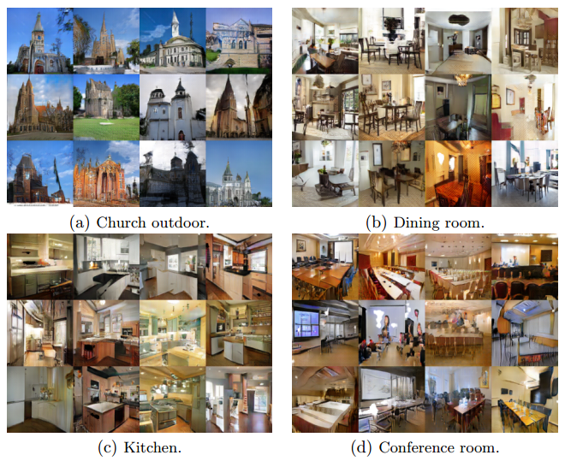
Generative Models: References
LSGAN by Mao, 2017

Slide 12
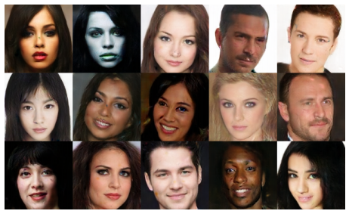
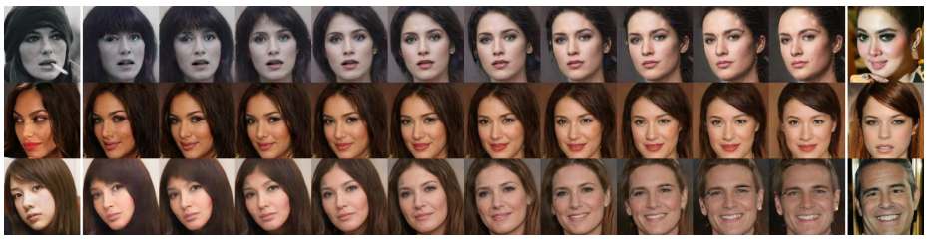
Generative Models: References
BEGAN by google, 2017. 03

Slide 13
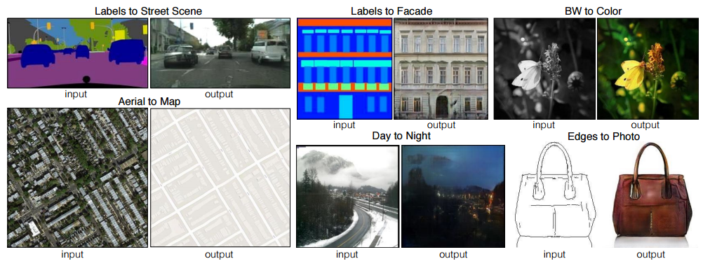
Generative Models: References
Pix2Pix by Isola, 2016. 11

Slide 14
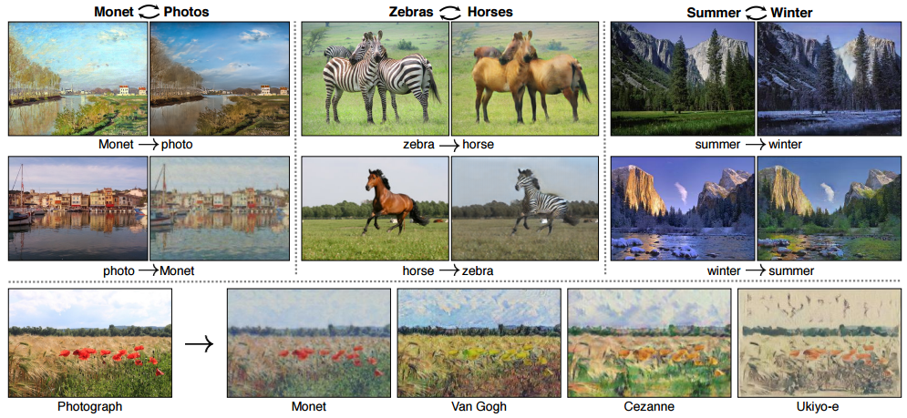
Generative Models: References
CycleGAN by Zhu, 2017. 03

Slide 15
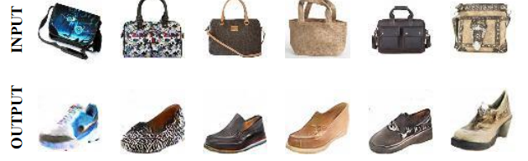
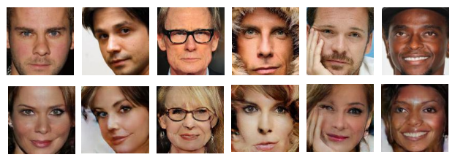
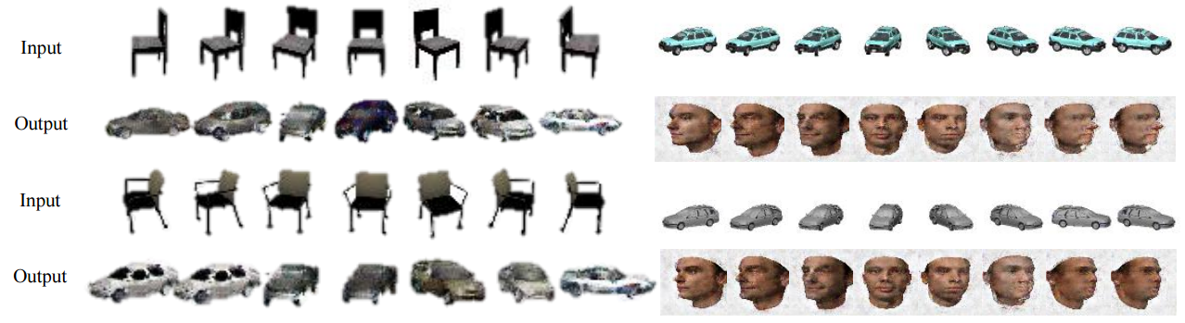
Generative Models: References
DiscoGAN by T. Kim, 2017. 05

Slide 16
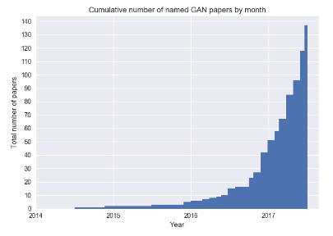
Generative Models: References
https://github.com/hindupuravinash/the-gan-zoo

Slide 17
우리는
GENERATIVE
모델 개발보다는
어떻게 가져다 쓸 건지가 더 중요
그러면 이해해야 한다!
오늘은 VAE/GAN만..

Slide 18
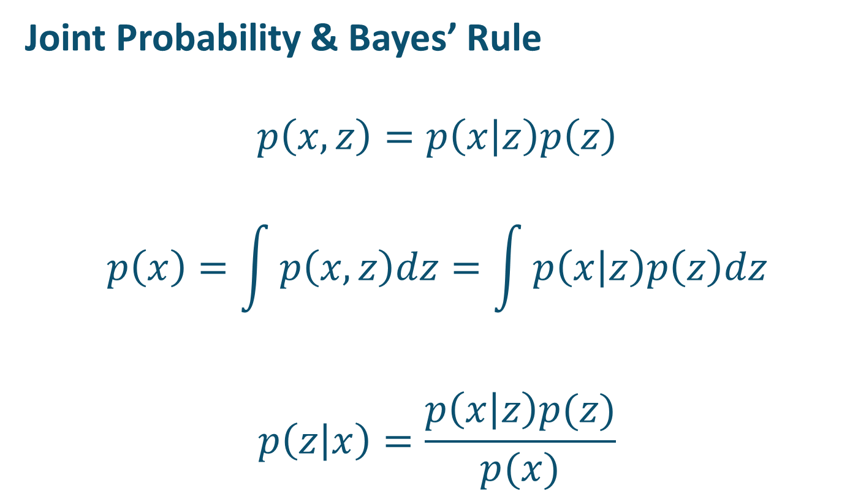
VAE: Backgrounds
Joint Probability & Bayes’ Rule
$$p\left(x,z\right)=p\left(x | z\right)p\left(z\right)$$
$$p\left(x\right)=\int{p\left(x,z\right)dz}=\int{p\left(x | z\right)p\left(z\right)dz}$$
$$p\left(z | x\right)=\frac{p\left(x | z\right)p(z)}{p(x)}$$
likelihood
prior
posterior
evidence

Slide 19
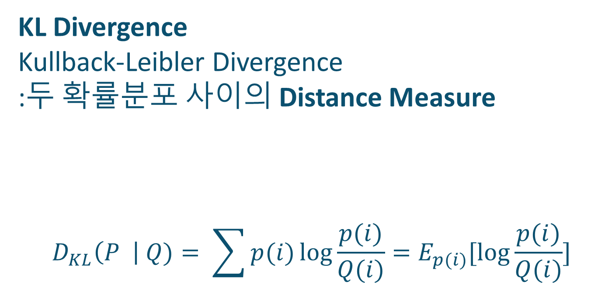
VAE: Backgrounds
KL Divergence
Kullback-Leibler Divergence
:두 확률분포 사이의 Distance Measure
$$D_{KL}\left(P \right| Q)= \sum{p(i)}\log{\frac{p(i)}{Q(i)}}=E_{p(i)}[\log{\frac{p(i)}{Q(i)}}]$$

Slide 20
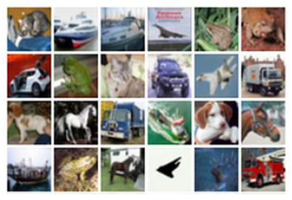
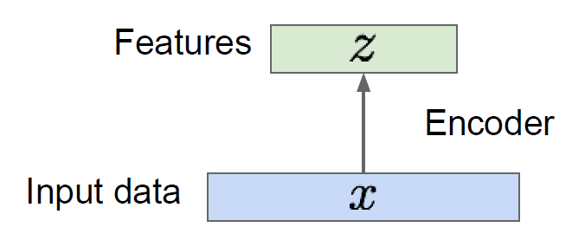
VAE: Backgrounds
AutoEncoders: Unsupervised Learning
How to Learn Lower-dimensional Features?
Images from cs231n

Slide 21
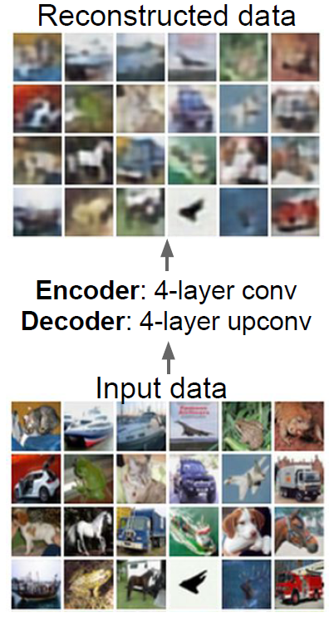
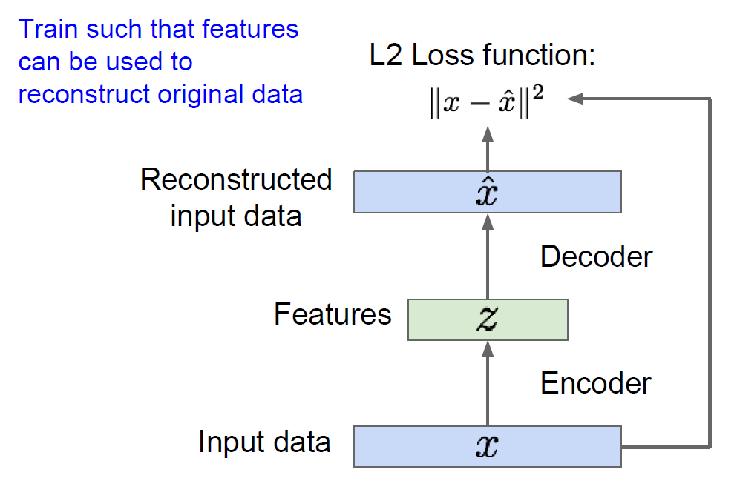
VAE: Backgrounds
AutoEncoders: Unsupervised Learning
How to Learn Lower-dimensional Features?
Images from cs231n

Slide 22
VAE: Backgrounds
AutoEncoders: Unsupervised Learning
How to Learn Lower-dimensional Features?
ReLU DNN/CNN
Images from cs231n

Slide 23
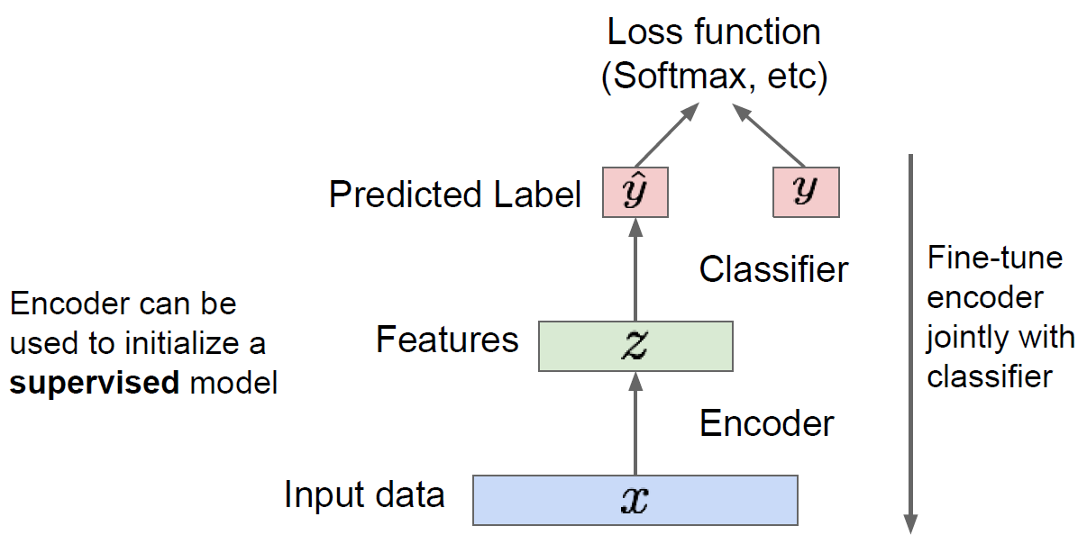
VAE: Backgrounds
AutoEncoders: Feature Learning
Images from cs231n

Slide 24
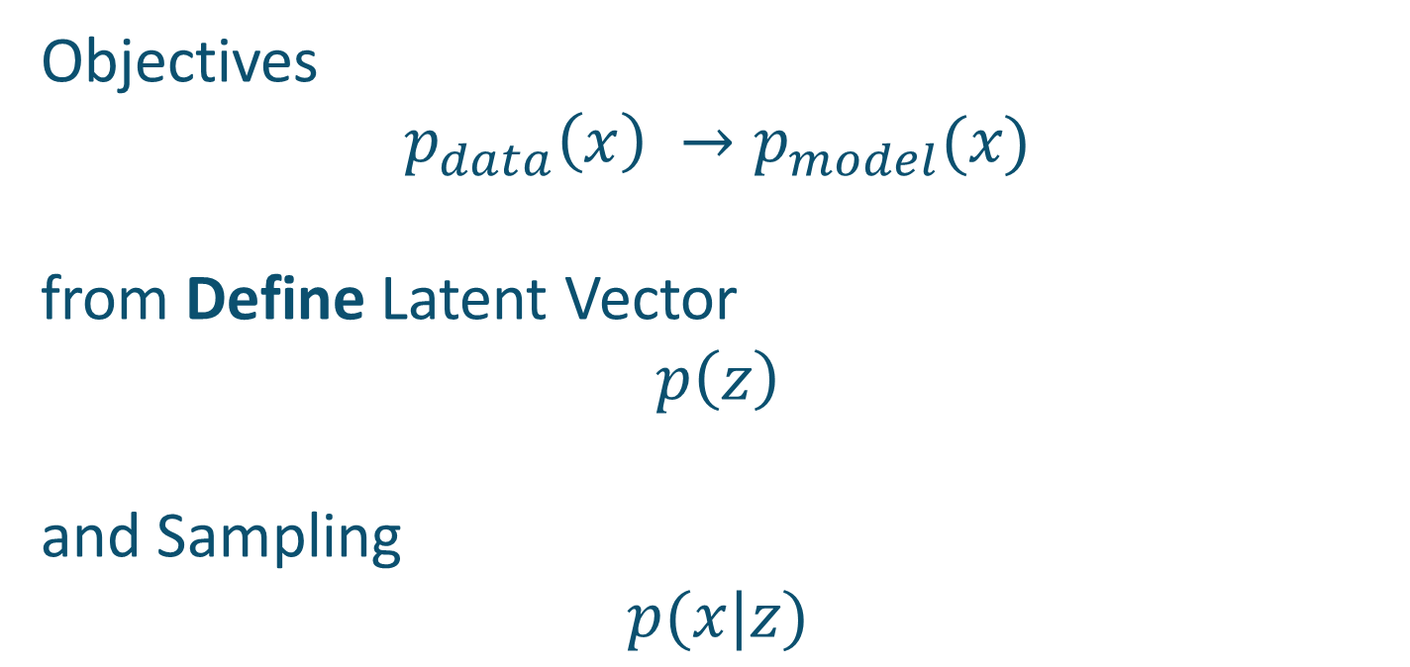
VAE
Objectives
$$p_{data}\left(x\right) →p_{model}(x)$$
from Define Latent Vector
$$p\left(z\right)$$
and Sampling
$$p(x|z)$$

Slide 25
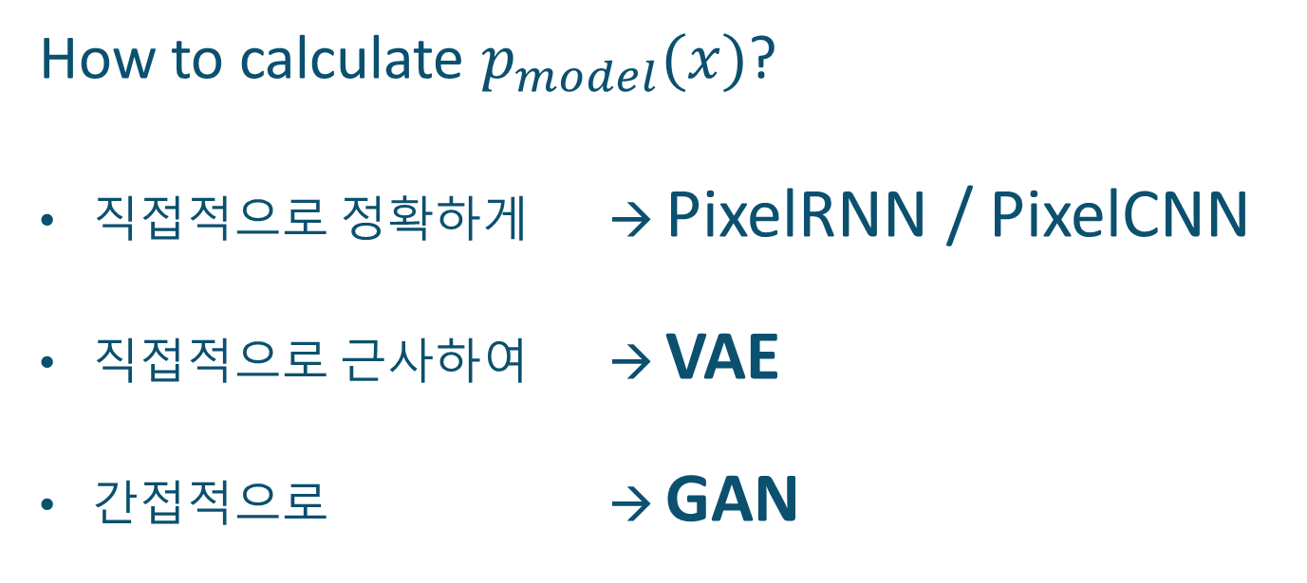
VAE
How to calculate $p_{model}(x)$?
직접적으로 정확하게 → PixelRNN / PixelCNN
직접적으로 근사하여 → VAE
간접적으로 → GAN

Slide 26
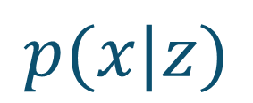
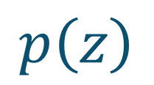
VAE
Algorithm
Generated
Output
$$p\left(z\right)$$
$$p(x|z)$$

Slide 27
VAE
Algorithm
Generated
Output
$$p\left(z\right)$$
$$p(x|z)$$
Gaussian
Complex Deep Neural Networks

Slide 28

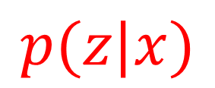
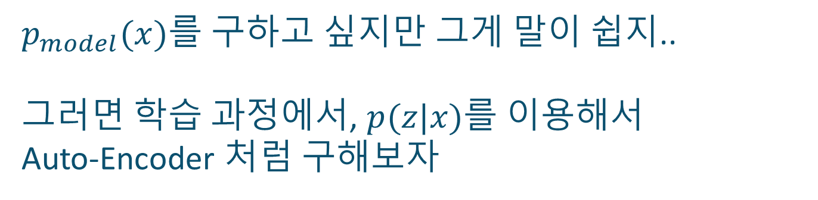
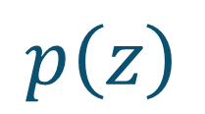
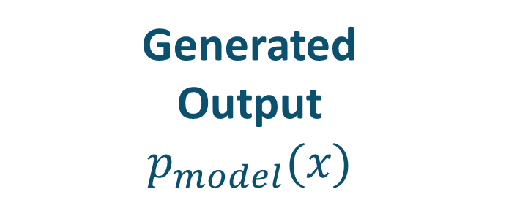

VAE
$p_{model}(x)$를 구하고 싶지만 그게 말이 쉽지..
그러면 학습 과정에서, $p(z|x)$를 이용해서
Auto-Encoder 처럼 구해보자
$$Input$$
Generated
Output
$$p_{model}(x)$$
$$p\left(z\right)$$
$$p(z|x)$$
$$p(x|z)$$

Slide 29
VAE
$p_{model}(x)$를 구하고 싶지만 그게 말이 쉽지..
그러면 학습 과정에서, $p(z|x)$를 이용해서
Auto-Encoder 처럼 구해보자
$$Input$$
Generated
Output
$$p_{model}(x)$$
$$p\left(z\right)$$
$$p(z|x)$$
$$p(x|z)$$
Encoder
Decoder

Slide 30
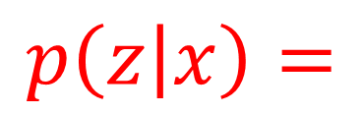
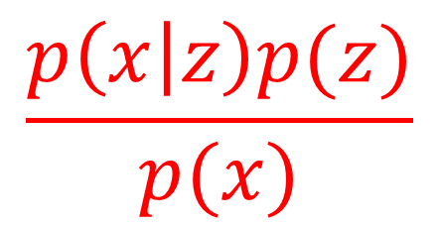
VAE
Decoder
Gaussian
$$\frac{p\left(x | z\right)p(z)}{p(x)}$$
$$p\left(z | x\right)=$$
Encoder
We Want!

Slide 31
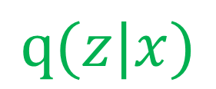
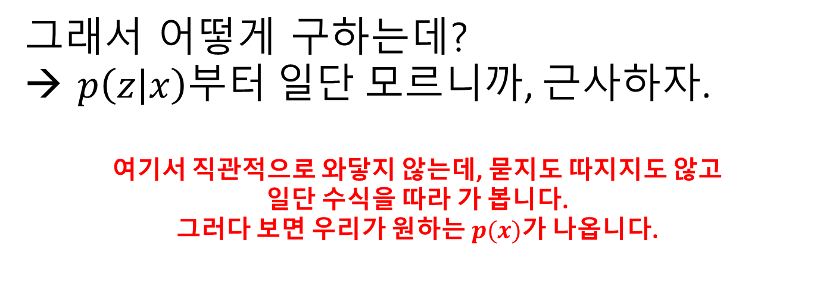
VAE
그래서 어떻게 구하는데?
→ $p\left(z | x\right)$부터 일단 모르니까, 근사하자.
여기서 직관적으로 와닿지 않는데, 묻지도 따지지도 않고
일단 수식을 따라 가 봅니다.
그러다 보면 우리가 원하는 $p(x)$가 나옵니다.
$$Input$$
Generated
Output
$$p\left(z\right)$$
$$p(z|x)$$
$$p(x|z)$$
$$q(z|x)$$

Slide 32
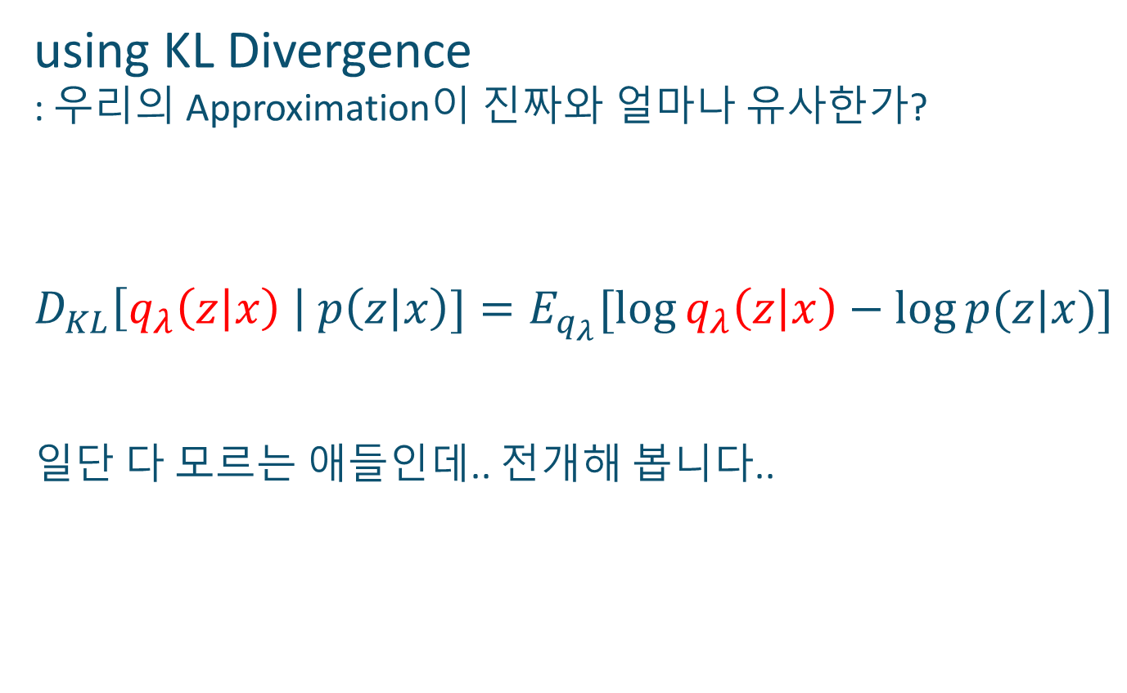
VAE
using KL Divergence
: 우리의 Approximation이 진짜와 얼마나 유사한가?
$$D_{KL}\left[q_{λ}\left(z | x\right) \right| p\left(z | x\right)]=E_{q_{λ}}[\log{q_{λ}\left(z | x\right)−\log{p(z|x)]}}$$
일단 다 모르는 애들인데.. 전개해 봅니다..

Slide 33
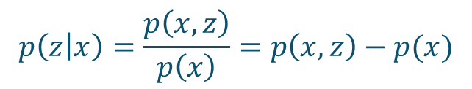
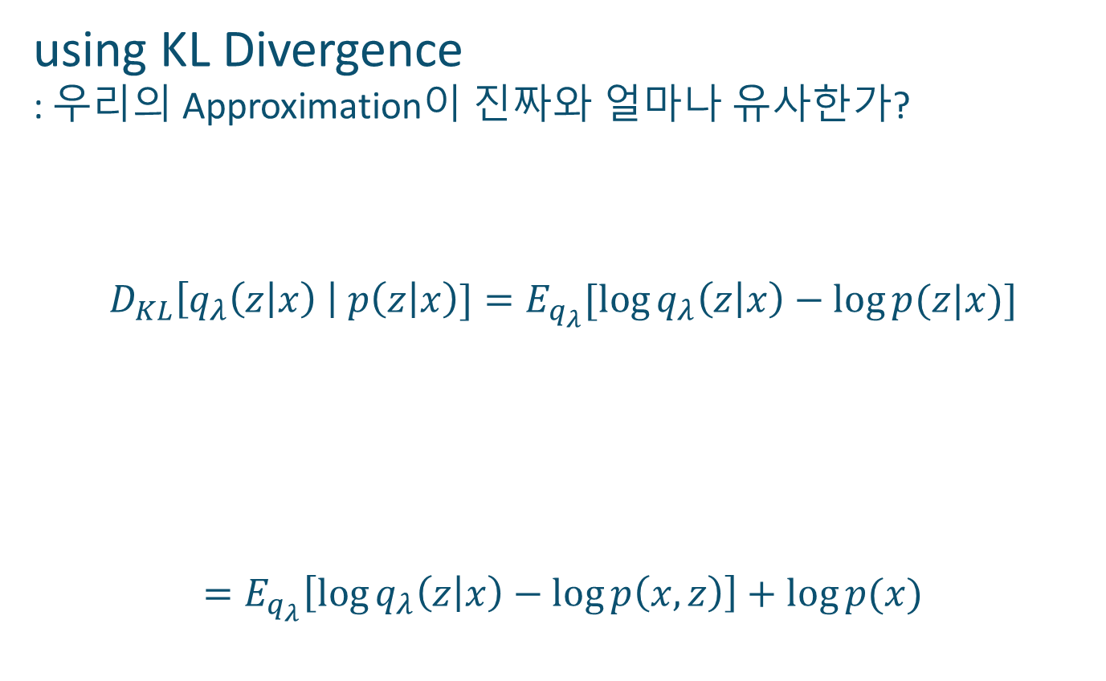
VAE
using KL Divergence
: 우리의 Approximation이 진짜와 얼마나 유사한가?
$$D_{KL}\left[q_{λ}\left(z | x\right) \right| p\left(z | x\right)]=E_{q_{λ}}[\log{q_{λ}\left(z | x\right)−\log{p(z|x)]}}$$
$$=E_{q_{λ}}\left[\log{q_{λ}\left(z | x\right)−\log{p\left(x, z\right)}}\right]+\log{p(x)}$$
$$p\left(z | x\right)=\frac{p\left(x,z\right)}{p\left(x\right)}=p\left(x,z\right)−p(x)$$

Slide 34
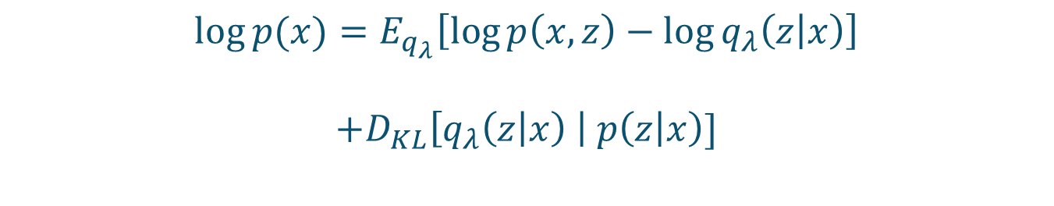

VAE: Variational Inference
$$D_{KL}\left[q_{λ}\left(z | x\right) \right| p\left(z | x\right)] \\ =E_{q_{λ}}\left[\log{q_{λ}\left(z | x\right)−\log{p\left(x, z\right)}}\right]+\log{p(x)}$$
$$\log{p(x)}=E_{q_{λ}}\left[\log{p\left(x, z\right)}−\log{q_{λ}\left(z | x\right)}\right]$$
$$+D_{KL}\left[q_{λ}\left(z | x\right) \right| p\left(z | x\right)]$$
Generated Output
의 Log-likelihood
이것을 최대화하는 Parameter를 구하는 것이 우리의 목표
얼떨결에 What we Want가 나왔다.

Slide 35
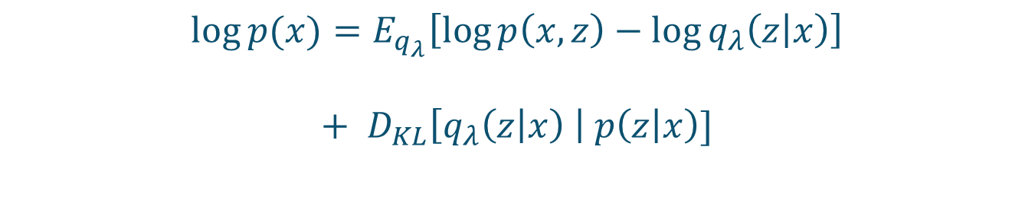
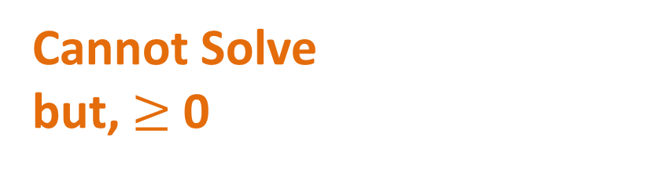
VAE: Variational Inference
$$D_{KL}\left[q_{λ}\left(z | x\right) \right| p\left(z | x\right)] \\ =E_{q_{λ}}\left[\log{q_{λ}\left(z | x\right)−\log{p\left(x, z\right)}}\right]+\log{p(x)}$$
Maximize
$$\log{p(x)}=E_{q_{λ}}\left[\log{p\left(x, z\right)}−\log{q_{λ}\left(z | x\right)}\right]$$
$$+ D_{KL}\left[q_{λ}\left(z | x\right) \right| p\left(z | x\right)]$$
Cannot Solve
but, $≥$ 0

Slide 36
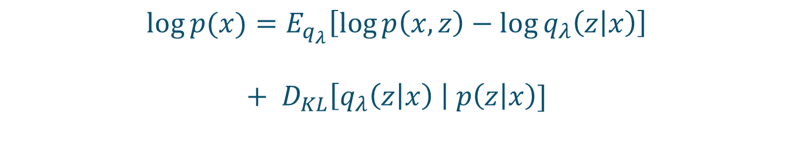

VAE: Variational Inference
$$D_{KL}\left[q_{λ}\left(z | x\right) \right| p\left(z | x\right)] \\ =E_{q_{λ}}\left[\log{q_{λ}\left(z | x\right)−\log{p\left(x, z\right)}}\right]+\log{p(x)}$$
Maximize
$$\log{p(x)}=E_{q_{λ}}\left[\log{p\left(x, z\right)}−\log{q_{λ}\left(z | x\right)}\right]$$
$$+{ D}_{KL}\left[q_{λ}\left(z | x\right) \right| p\left(z | x\right)]$$
$≥$ 0
Maximize this
Lower Bound! called ELBO

Slide 37
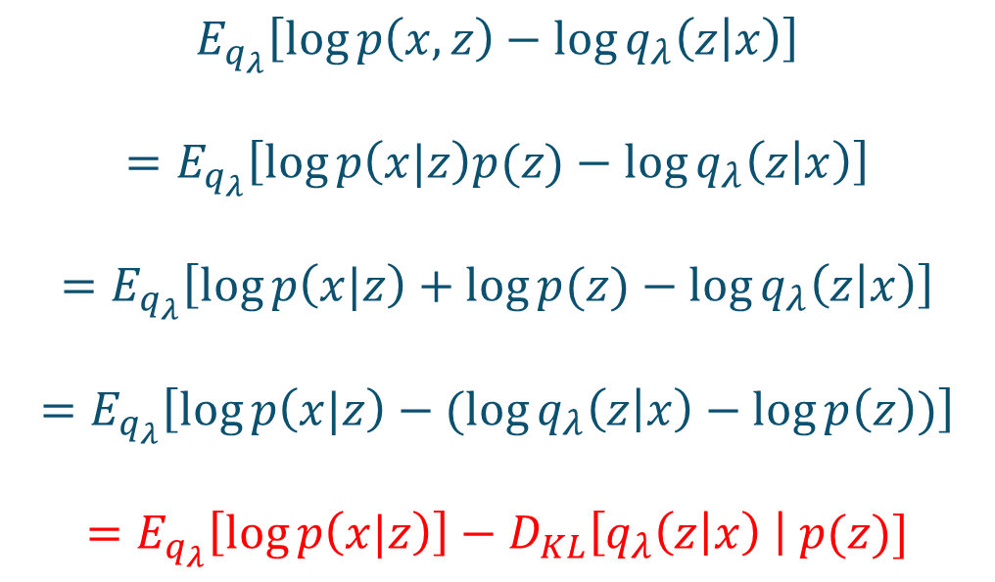
VAE: Maximize ELBO
$$E_{q_{λ}}\left[\log{p\left(x, z\right)}−\log{q_{λ}\left(z | x\right)}\right]$$
$$=E_{q_{λ}}\left[\log{p\left(x|z\right)p(z)}−\log{q_{λ}\left(z | x\right)}\right]$$
$$=E_{q_{λ}}\left[\log{p\left(x|z\right)}+\log{p(z)}−\log{q_{λ}\left(z | x\right)}\right]$$
$$=E_{q_{λ}}\left[\log{p\left(x|z\right)}−(\log{q_{λ}\left(z | x\right)}−\log{p\left(z\right)})\right]$$
$$=E_{q_{λ}}\left[\log{p\left(x|z\right)}\right]−D_{KL}\left[q_{λ}\left(z | x\right) \right| p(z)]$$

Slide 38
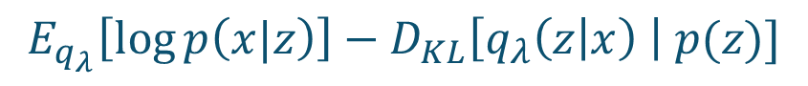
VAE: Maximize ELBO?
$$E_{q_{λ}}\left[\log{p\left(x|z\right)}\right]−D_{KL}\left[q_{λ}\left(z | x\right) \right| p(z)]$$
Maximize Likelihood
ex) Supervised Learning
: Good Classification
In this Case
: Good Reconstruction
Switch to Reconstruction Error
(MSE / Cross Entropy ... )

Slide 39
VAE: Maximize ELBO?
$$E_{q_{λ}}\left[\log{p\left(x|z\right)}\right]−D_{KL}\left[q_{λ}\left(z | x\right) \right| p(z)]$$
Minimize KL-Divergence
= Good Approximation
→ Regularizer

Slide 40
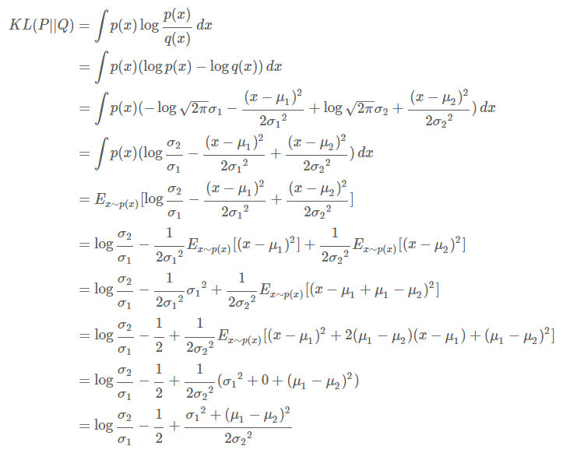
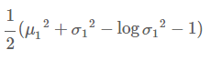
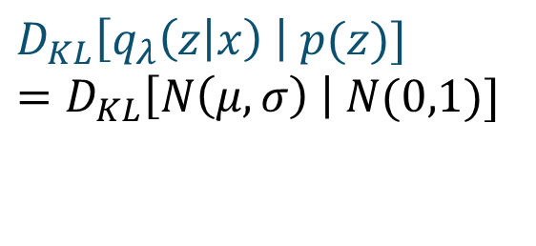
VAE: Regularization Term
$$D_{KL}\left[q_{λ}\left(z | x\right) \right| p(z)]$$
$$=D_{KL}\left[N\left(μ,σ\right) \right| N(0,1)]$$

Slide 41


VAE: Loss Function
$$\arg{\max_{q_{λ}}{E_{q_{λ}}\left[\log{p\left(x|z\right)}\right]−D_{KL}\left[q_{λ}\left(z | x\right) \right| p(z)]}}$$
$$\arg{\min_{q_{λ}}{ReconLoss+D_{KL}\left[q_{λ}\left(z | x\right) \right| p(z)]}}$$
Cross Entropy
in MNIST Example

Slide 42

VAE: Loss Function Code

Slide 43





VAE: Re-parameterization Trick
I
n
p
u
t
R
e
c
o
n
$$σ$$
Sample
from
$$N\left(μ,σ\right)$$
$$μ$$
$$D_{KL}\left[N\left(μ,σ\right) \right| N(0,1)]$$
$$ReconLoss$$

Slide 44
VAE: Re-parameterization Trick
I
n
p
u
t
R
e
c
o
n
$$σ$$
Sample
from
$$N\left(μ,σ\right)$$
$$μ$$
Sampling
= Non-differentiable
= Cannot Train
using BP
$$D_{KL}\left[N\left(μ,σ\right) \right| N(0,1)]$$
$$ReconLoss$$

Slide 45







VAE: Re-parameterization Trick
Solution
Sample
from
$$N\left(0,1\right)$$
$$ε$$
I
n
p
u
t
R
e
c
o
n
$$σ$$
$$z=μ+εσ$$
$$μ$$
$$D_{KL}\left[N\left(μ,σ\right) \right| N(0,1)]$$
+ = Loss
$$ReconLoss$$

Slide 46

VAE: Example Code
PyTorch/Ubuntu14
https://github.com/yunjey/pytorch-tutorial/
tree/master/tutorials/
03-advanced/variational_auto_encoder

Slide 47

VAE: Example Code

Slide 48


VAE: Results
PyTorch/Ubuntu14
https://github.com/yunjey/pytorch-tutorial/tree/master/tutorials/03-advanced/variational_auto_encoder
Epoch 1
Epoch 50

Slide 49
VAE: Results
z for
Smile
z for Rotation

Slide 50
VAE: Results
MNIST in 2D
Can Easily Classify

Slide 51
VAE: Why VAE is important?
GAN을 하다 보면.. VAE의 단순함이 좋음
Objective Function이 명확함
단순한 Example에는 VAE가 좋음
확률 문제를 최적화 문제로 바꿈
(최적화 문제는 Neural Network로 설계하면 쉽게 풀림)
Auto-Encoder로 Modeling하여
Gradient Descent로 푼다

Slide 52
You Can See Again
@
https://taeoh-kim.github.io/blog/blog/generative-models-part-1/

Slide 53
Thank You
Qusetion?

